Slide 1
Chapter 12
Program Development
Notes:
Welcome to Chapter 12 of Visualizing Technology, fifth edition, by Debra Geoghan. This chapter will cover program development.

Slide 2
Objectives
Describe the System Development Life Cycle
Describe the Program Development Cycle
Compare Various Programming Languages
Explain the Term Artificial Intelligence
Notes:
Chapter 12 Explains And Discusses The Program Development Life Cycle. The Chapter Objectives Are:
Describe The System Development Life Cycle
Describe The Program Development Cycle
Compare Various Programming Languages
Explain The Term Artificial Intelligence

Slide 3

Describe the System
Development Life Cycle
Objective 1
Notes:
This objective explores models for developing an information system and the system development life cycle.

Slide 4
Getting from Idea to Product
System Development Life Cycle
Also called waterfall approach
Each phase must be completed in order for the next phase to begin
This method is rigid
Process begins with request for new system or replacement for old one
Objective 1
Notes:
The System Development Life Cycle (SDLC) is sometimes referred to as the waterfall approach. In this process, each phase must be completed in order before the next phase begins. The process begins when there is a request for a new system or a replacement for an old one.

Slide 5
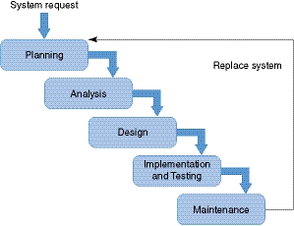
Getting from Idea to Product
System Development Life Cycle
Objective 1
Notes:
The steps in the System Development Life Cycle (SDLC) are the planning stage, the analysis stage, the design phase, the implementation and testing stage, and maintenance stage. If during maintenance the system is determined not to meet the current needs of the business, the process returns to the planning stage.

Slide 6
Getting from Idea to Product
System Development Life Cycle
Planning Phase of the SDLC
  Project team
    Stakeholders, software developers, and a project manager (PM)
  Feasibility study
    Economic
    Technical
    Operational
    Political
Objective 1
Notes:
In the planning phase, the project team is assembled and feasibility studies are completed. The project team consists of the stakeholders, software developer, and the project manager.
A feasibility study includes the creation of the terms of reference or project charter, which states the objectives and scope of the project, the timeline for the project, risks, participants, deliverables, and budget.

Slide 7
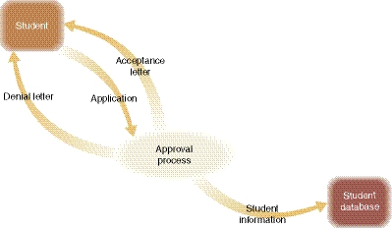
Getting from Idea to Product
System Development Life Cycle
Analysis Phase of the SDLC
  Data flow diagrams (DFD)
    Shows the flow of data through the current system
    Highlights the system’s deficiencies
  Requirements analysis
    Result is a system specification report
  System specification report
    A logical model of the new system
Objective 1
Notes:
The goal of the analysis phase is to produce the list of requirements. Data flow diagrams (DFD) are created to show the flow of data through the current system and to highlight its deficiencies. Requirements analysis produces information about existing business processes and the changes needed. The result is a logical model of the new system called a system specification report.

Slide 8

Getting from Idea to Product
System Development Life Cycle
Design Phase of the SDLC
  Select a solution that meets
  the requirements
  Cost-effective options
  Design of system begins
  Application specifications written if system will be built instead of purchased
Objective 1
Notes:
In the design phase, potential solutions are evaluated, and the best solution is selected. This step involves choosing the option that best meets the requirements using the most cost-effective methods, hardware, software, and human resources. In this phase, the designing of the system begins. If it’s determined that the system has to be built rather than purchased, then application specifications are written.

Slide 9
Getting from Idea to Product
System Development Life Cycle
Implementation and Testing Phase of the SDLC
  Programmers use designs and specifications to create the system
  Programs written in modules
    Unit testing
    Integration or link testing
    Volume testing
    Acceptance testing
    User training takes place
  User training and installation occurs
Objective 1
Notes:
During the implementation and testing phase, coding takes place and the system is installed. Programs are usually written in modules that undergo individual unit testing. Integration or link testing ensures that the modules work together. Volume testing assures that the system can handle the expected volume of data. Finally, acceptance testing verifies that the system does what it’s supposed to do. During this phase, training takes place and the system is installed and brought online.

Slide 10
Getting from Idea to Product
System Development Life Cycle
Maintenance Phase of the SDLC
  System may change or be updated
  Security holes and bugs fixed
  New features added
  Retraining as needed
  Documentation updated
  Day-to-day operational maintenance
    Monitoring performance
    Installing updates and patches
    Creating and restoring backups
Objective 1
Notes:
The maintenance phase includes periodic reviews to ensure the system still meets the needs of the business. During this period, the system may change or be updated, security holes and bugs are fixed, and new features might be added. Users may need to be retrained and documentation updated as a result of these changes. Day-to-day operational maintenance includes monitoring performance, installing updates and patches, and creating and restoring backups. The maintenance phase is the longest phase.

Slide 11


Getting from Idea to Product
Other Development Models
Joint Application Development (JAD)
Rapid Application
Development (RAD)
Agile Development
Objective 1
Notes:
Joint Application Development (JAD) is a more collaborative process than the SDLC and involves the end user throughout the design and development of the project through a series of JAD sessions. Using JAD results in shorter development times because of the continued involvement of users throughout the development process.
Rapid Application Development (RAD) is an iterative process that uses prototyping and user testing of the designs.
Agile Development is an incremental and iterative process that uses short iterations or sprints with the project team stopping and reevaluating the direction of a project every two weeks. At the end of each iteration, testing is done, and stakeholders review progress and reevaluate priorities. Projects are adjusted along the way as needs and business conditions change. Agile Development is a rapid and adaptive development model.

Slide 12

Describe the Program Development Cycle
Objective 2
Notes:
Objective 2 describes the Program Development Cycle.

Slide 13
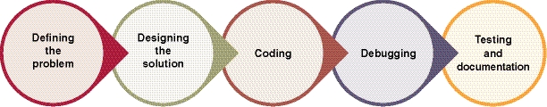
Coding the System
Program Development Cycle
Defining the Problem
  What data will be provided (input)?
  What will the program do (processing and output)?
Designing the Solution
  Algorithm
    Set of steps to solve
    problem
    Each step performs
    a single task
Objective 2
Notes:
An algorithm is a set of steps to solve a problem. It should be a clear and simple statement that breaks down the solution into small modules, each of which performs a single task.

Slide 14
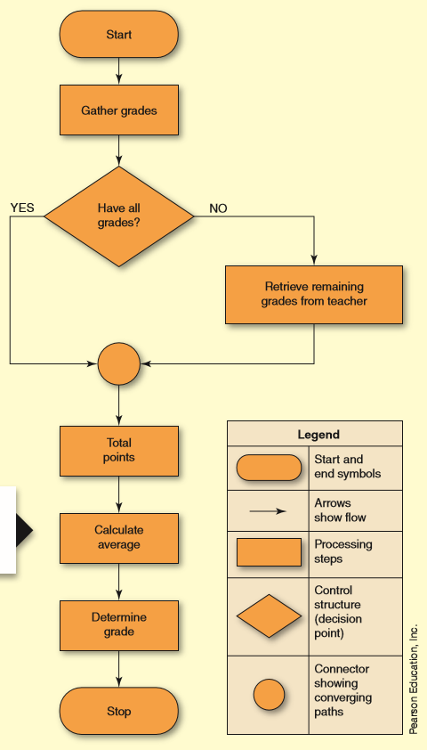
Coding the System
Program Development Cycle
Flowchart
  Graphic view of algorithm
    Arrows to show direction
    Other symbols to show actions
    and data
Control structures
    Show logic and flow of data
    processing
Objective 2
Notes:
A flowchart is a graphic view of the algorithm. Flowcharts use arrows to show direction and other symbols to show actions and data. These are standard flowchart symbols used by most programmers. This flowchart illustrates the algorithm used to calculate your grade and includes a section of control structures. Control structures are used in flowcharts and pseudocode to show logic and the flow of data processing. Common control structures include sequence, selection, and loop.

Slide 15
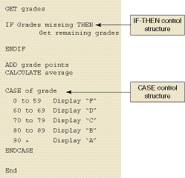
Coding the System
Program Development Cycle
Pseudocode
  Steps of an algorithm
    More detail
    English-like statements
    Focus on logic, not syntax
    Contains control structures
    Not executable
Objective 2
Notes:
Pseudocode expresses the steps of an algorithm using English-like statements that focus on logic, not syntax. It is close to what a program will look like, is not specific to any one programming language, and is not executable.

Slide 16
Coding the System
Program Development Cycle
Coding
  Converting algorithm into instructions computer can understand
  Considerations:
    Type of task
    Platform
    Expertise of the programmer
  Choosing the right language
      Procedural programming
      Object-oriented programming
      Syntax rules – the correct construction of commands in a language
Objective 2
Notes:
Coding, or computer programming, is the process of converting the algorithm into instructions the computer can understand. The type of task, platform to be run on, and the expertise of the programmer are all considerations. Different languages are optimized for different tasks, so choosing the right language will result in a better solution.
Coding is accomplished using either procedural programming or object-oriented programming. Syntax rules define the correct construction of commands in a programming language.

Slide 17

Coding the System
Program Development Cycle
Debugging - The Process of Detecting and Fixing Errors
    Syntax Error
      Error in way code is written
      Typo, missing parameter,
      incorrect use of symbols
      Easy to spot by reviewing line
      by line
      Will prevent program from
      running
Objective 2
Notes:
Debugging is the process of detecting and fixing errors in a computer program. There are three types of errors: syntax errors, logic errors, and runtime errors.
A syntax error is an error in the way the code is written.

Slide 18
Coding the System
Program Development Cycle
Debugging - The Process of Detecting and Fixing Errors
    Logic Error
      Error in programming logic
      Results in unexpected outcome
      More difficult to detect
      Does not prevent a program from running
Objective 2
Notes:
A logic error is an error in programming logic that results in an unexpected outcome.

Slide 19
Coding the System
Program Development Cycle
Debugging - The Process of Detecting and Fixing Errors
    Runtime Error
      Occurs when program is running and something entered causes it to crash
      Memory issues are common cause of runtime errors
Objective 2
Notes:
A runtime error occurs when the program is running and data or a command that is entered causes it to crash.

Slide 20

Coding the System
Program Development Cycle
Testing and Documentation
  Beta testing
    Testing done under actual
    working conditions
  Documentation
    Created throughout programming cycle
    For users
    For programmers
Objective 2
Notes:
Once the program has been debugged, it needs to be tested under actual working conditions; this is beta testing. Documentation is created throughout the programming cycle and written both for the user and for programmers. Documentation for users includes both print and online user manuals. For programmers, documentation includes comments within code and external documentation that outlines the project, problem, and design logic.

Slide 21

Compare Various Programming Languages
Objective 3
Notes:
Objective 3 compares various programming languages.

Slide 22
Tools of the Trade
Programming Languages
Low Level
  First-generation (1GL)
    Machine language
    Written in binary
  Second-generation (2GL)
    Assembly language
    Closer to what humans speak
Objective 3
Notes:
A first-generation language (1GL) is a machine language written in binary that can execute very quickly but takes a lot of effort to write and debug.
A second-generation language (2GL) is an assembly language. It’s written with statements closer to what humans speak and has to be converted into a machine language by an assembler before the computer can execute it

Slide 23
Tools of the Trade
Programming Languages
High-level
  Third-generation (3GL)
    Procedural and object oriented languages
    Requires considerable amount of programming knowledge
    Compiler converts code into machine language
  Fourth-generation (4GL)
    Closer to natural language than 3GL
  Fifth-generation (5GL)
    Primarily used in artificial intelligence applications
Objective 3
Notes:
Most modern programming languages are third-generation languages (3GLs). These include both procedural and object-oriented languages.
A fourth-generation language (4GL) is designed to be closer to natural language than a 3GL.
A fifth-generation language (5GL) is a system a user can work with without writing code. The 5GL creates the code. 5GLs are primarily used in artificial intelligence applications.

Slide 24
Tools of the Trade
Programming Tools
Software development kit (SDK)
  A bundle of libraries and tools for a particular platform
Integrated development environment (IDE)
  Complete system for developing software
Platform-as-a-Service (PaaS)
  Online programming environment
  Develop and test applications
  Deploy custom applications
Objective 3
Notes:
A software development kit (SDK) is a bundle of libraries and tools that are developed for a particular platform. An integrated development environment (IDE) is a complete system for developing software, typically consisting of a code editor, one or more compilers, one or more SDKs, and a debugger. Platform-as-a-Service (PaaS) is an online programming environment used to develop, test and deploy custom applications.

Slide 25
Tools of the Trade
Web Programming
Select right language for task
Simplest form of a webpage
  Static HTML page
Dynamic elements
  Menus
  Rollovers
  Searches
  Videos
  Animation
Objective 3
Notes:
Developing web applications requires selecting the right language for the task. The simplest form of a webpage is a static HTML page. Modern webpages are rarely static. Dynamic elements such as menus, rollovers, searches, videos, and animation make web programming more complex.

Slide 26
Tools of the Trade
Web Programming
Server-side
  Processing takes place on server
  Results sent to client as HTML
  Client does not need special software – other than a browser
Objective 3
Notes:
A server-side program runs on a web server. Server-side programming languages include Perl, ASP, PHP, JSP, and ColdFusion. Because the processing takes place on the server side and results are sent to the clients as HTML, the client does not need to have special software – other than a browser.

Slide 27
Tools of the Trade
Web Programming
Client-side
  Coding is within webpage
  Downloaded to client computer
  Compiled and executed by browser or plug-in
Objective 3
Notes:
A client-side program runs on the client computer. The coding is done within a webpage, downloaded to the client computer, and compiled and executed by a browser or plug-in. The most popular client-side elements are JavaScript, ActiveX controls, and Java applets. Client-side programming is often called scripts and requires the user to have the proper browser and plug-in installed.

Slide 28

Tools of the Trade
Mobile App Features
Works well
Market appeal
Generates income
  Pay-per-download
  Subscription
  In-app purchases – charges for more lives or level – called micropayments
  In-app advertising
Objective 3
Notes:
Revenue from mobile apps for cell phones and tablets is expected to reach $92 billion by 2018. In order for a mobile app to be a success, the app needs to work well, have market appeal, and generate income.
Green computing is usually associated with the act of turning off hardware when not in use. However, green computing also refers to the writing of green code, code that runs on hardware with minimal impact.

Slide 29

Explain the Term Artificial Intelligence
Objective 4
Notes:
Objective 4 explains the term artificial intelligence.

Slide 30

Artificial Intelligence
Applications
Branch of science
Uses 5G languages
  LISP
  Prolog
Objective 4
Notes:
Artificial intelligence (AI) is the branch of science concerned with making computers behave like humans. Modern applications include weather forecasting, speech and pattern recognition, science and engineering applications, and financial predictions. Two of the most common programming languages used in AI development are the 5G languages LISP and Prolog.

Slide 31
Artificial Intelligence
Expert Systems
Make decisions in real-life situations
Simulated human judgment
Uses fuzzy logic
  Answers questions that do not
  have clear yes or no answer
  Applications
    Diagnose illness
    Approve mortgage applications
    Schedule delivery routes
    Play chess
Objective 4
Notes:
An expert system is a computer programmed to make decisions in real-life situations. It is developed by knowledge engineers who study the way humans make decisions and translate that process into a set of rules. Expert systems diagnose illness, decide whether to approve a mortgage application, schedule delivery routes, and even play chess. An expert system uses fuzzy logic, which recognizes that not everything can be broken down to a true or false answer.

Slide 32
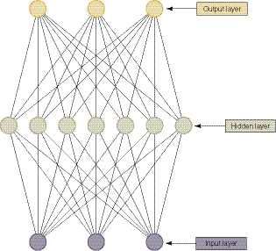
Artificial Intelligence
Neural Networks
Emulate biological connections, neurons, of the human brain
Three layers
  Input layer
  Output layer
  Middle, hidden layer
Objective 4
Notes:
Neural networks simulate the way humans think by emulating the biological connections in our brains. Neural networks consist of several layers. Data is placed into the input layer and results into the output layer. The magic happens in the hidden, middle layer. A network is first trained by feeding in large amounts of data – both the input and expected output. This data is then used to create the processes of the middle layer.

Slide 33

Questions
Notes:
Are there any questions?

Slide 34
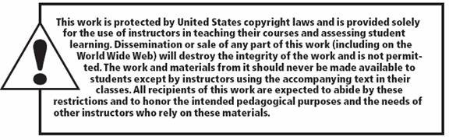
All rights reserved. No part of this publication may be reproduced, stored in a retrieval system, or transmitted, in any form or by any means, electronic, mechanical, photocopying, recording, or otherwise, without the prior written permission of the publisher. Printed in the United States of America.

